Slide 1



Computer Engineering Department A.P. Shah Institute of Technology G.B.Road,Kasarvadavli, Thane(W), Mumbai-400615 UNIVERSITY OF MUMBAI Academic Year 2021-2022

Slide 2

Synopsis on
APSIT BOOKSTORE
Submitted in partial fulfillment of the degree of Bachelor of Engineering(Sem-4) in Computer Engineering By
Ms. Mansi Gupta(20102133)
Ms. Anjali Divekar(20102105)
Ms. Shivangi Kumar(20102132)
Ms. Vaishnavi Kothari(20102138)
Under the Guidance of
Prof. Bharti Khemani

Slide 3

ABSTRACT
This project aims at creating an efficient and reliable online reference books and text books accessing platform for engineering students.
After the implementation of project, users can access the soft copy of any book available in the store from anywhere.
Currently the study materials are scattered but this project allows all them to be present in one place.
The books are classified year and their respective semester.
The use of the proposed online software keeps the record of the books suggested by MU.

Slide 4

1.1 Problem definition
The current system involves either buying of costly reference books or searching the library for limited available copies.
Even the materials available online are scattered and not available on one single platform.
The aim is to build a website that will contain the reference books recommended by MU on a single platform classified semester wise.

Slide 5

1.2 Objective
Here we try to develop such type of system which provides access to only selective students through admin for the books.
It keeps the record of books recommended by MU.
It helps the users to read the books without any complexity.
It saves the time of users by providing access to bookstore from anywhere.
Online bookstore allows its users to search a book online based on title, author and subject.
The user can also give feedback to a book by giving ratings on a score of five and can also leave a review. This can be helpful for the users who intend to find the best among the others.

Slide 6
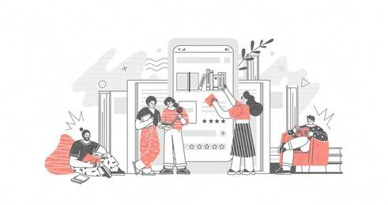
1.3 Scope
This project has a wide scope, as it is intended only for students of APSIT. This project is going to develop generic software, which can be applied by any businesses organization.
It aims at reducing user's searching time and also providing user friendly environment.
More over it provides facility of searching through various books sorted category wise and accessing books from anywhere. Also the software is going to provide a huge amount of summary data. It allows the admin to keep a record of the users and provide them login access.

Slide 7

1.4 Existing System/Project
Currently we have to take out time search any bookstore or library if we want to refer a book.
In the present system to generate the reports based on the management requirement, extensive searching of records is needed.
Also in the present system user and admin have to do all the work manually.
During issuing order of more stock, the project register is required to check to availability of stock in hand and it takes time to check records.
Many a times we have to wait a lot to issue or purchase a book if there is a lot of rush in libraries and stores.
And sometimes the book we need to borrow or buy is also unavailable due to limited stock.
Offline stores are restricted by time.

Slide 8

2 Technology Stack
Front-End : JSP, Html, CSS, JS.
Server-side: Servlet.
Back-end: MYSQL, Java, PHP.
Server: Tomcat 8.5.

Slide 9

3.1 Benefits For Environment
In printing of books lot of paper is utilized which means more deforestation. Downloading or reading from a pdf can reduce deforestation.
Whenever you prefer an eBook you are essentially bypassing the old requirement of a fossil fuel vehicle to deliver or pick up the product. The production of printed books produces about 10 times more CO2 in the atmosphere than eBooks.
Printing books also require a lot of electricity to produce traditional books.
Even though book stores that sell books are fun places to spend time and read, think of all the amount of energy required to warm or cool such a large store.
Physical presence of a bookstore also takes up a lot of land space. This land otherwise can also be utilized for greener means like planting trees, gardens or farming.

Slide 10

3.2 Benefits For Society
Those who have bookstores situated far from their places have to take transport to reach there. With the help of an online bookstore this issue can be resolved.
In remote areas even if there are libraries, they lack good reference books for higher studies.
It saves time and money.
Reading from a pdf makes it portable. You can continue your reading even if you are moving.
The pdf of reference books is provided for free so everyone can afford them.
They don’t have to deal with online payment portals and cart systems.

Slide 11
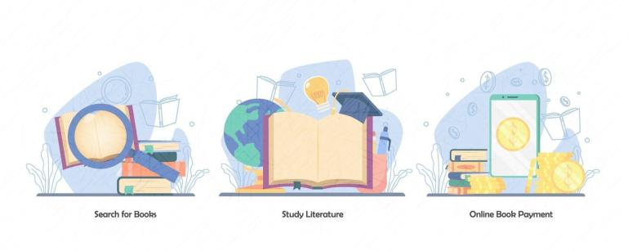
3.3 Applications
The system can be very well used by the colleges under MU to provide an ease of access to their students.
The system can also be implemented in publishing houses.
Your retail bookstore/library has a limited amount of space to hold and display certain book titles, which can restrict readers’ choices. Having an online database allows you to offer a wide range of titles and increase their exposure to all the stock you have.
The stock never ends.
A bookstore’s presence online can give your business an edge to earn great results and meet the evolving needs of the modern customer.
This online store is not limited and is free.

Slide 12

Project Design
Proposed System
In this project you can view any book very easily online.
This is controlled by a admin who have full control over all the books and users.
Online bookstore provides a platform where all the books are kept in an arranged way and you can choose your required book by just selecting it from the store. While selecting book one can view the reviews of other users.
Chances of theft are very less.

Slide 13
Admin Portal
Books PDF
Years and Semesters
Website
Reviews

Slide 14

Modules
Website:- Creation of the main website using html, css, javascript and php.
Admin Portal: – The admin in the admin portal adds the user along with their details.
Years and Semesters: – The website is classified into years and years are classified into their respective semesters.
Books PDF: – PDF of the books semester wise is provided.
Reviews: The users can leave reviews and ratings for the entire website as well as books of each subject individually.

Slide 15
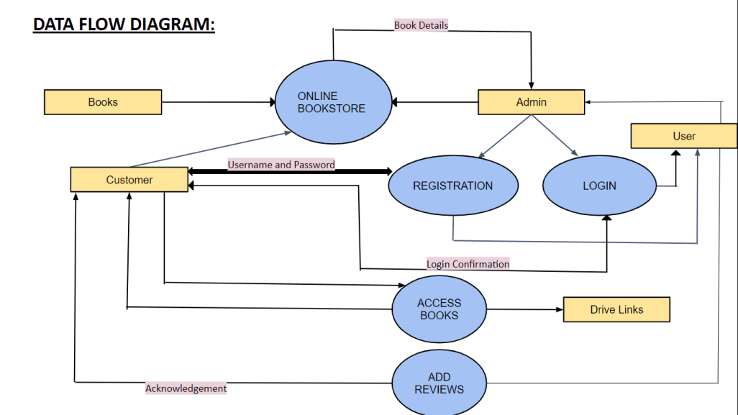

Slide 16
Browse and query books
Login
Browse Home Page
Perform advance search
Add/Delete books
USER
ADMINISTRATOR
Contact
Rate a book
Manage requests
Main Account
Register/Login
Update profile
Add/Delete category
Logout
Add/Delete members
View
Add Reviews
Add
Check Stock
Delete
Access Books
Update stock
View pdf
Download pdf
Logout

Slide 17
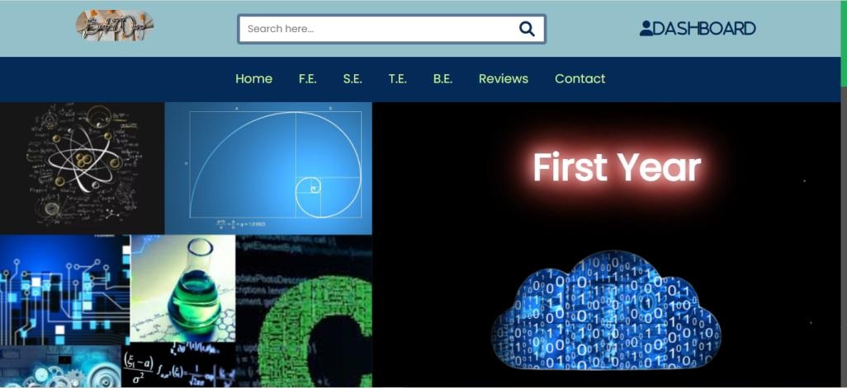
Project Implementation
Frontend:

Slide 18


Slide 19
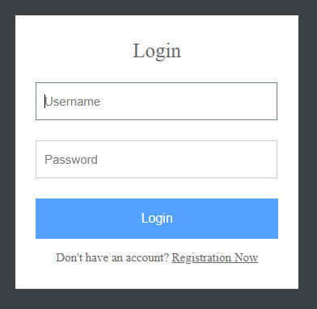

Slide 20
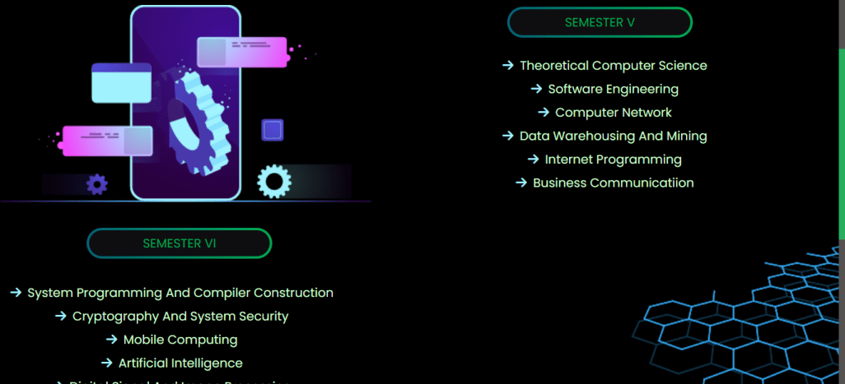

Slide 21
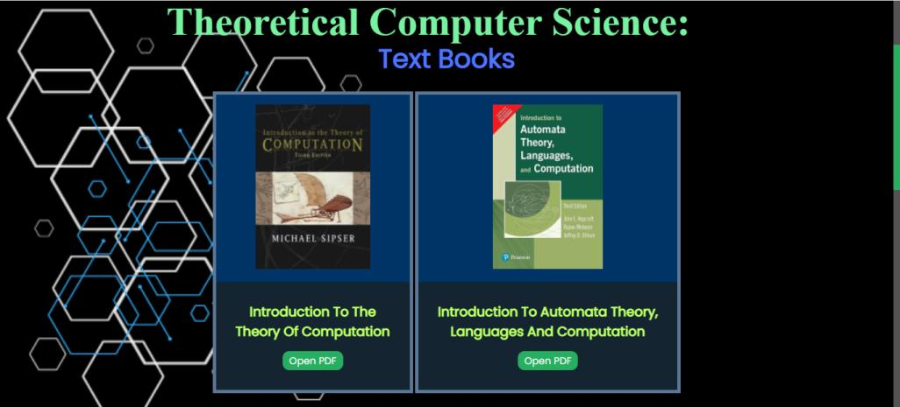

Slide 22

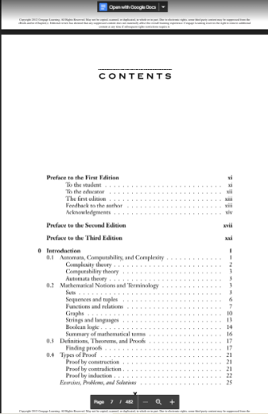
Books:

Slide 23
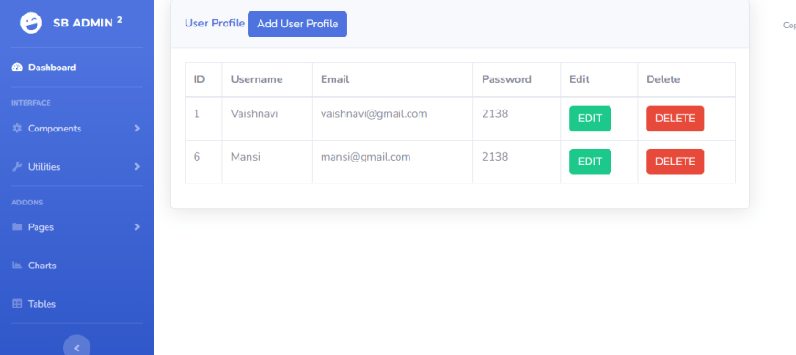
Dashboard:
Frontend:

Slide 24
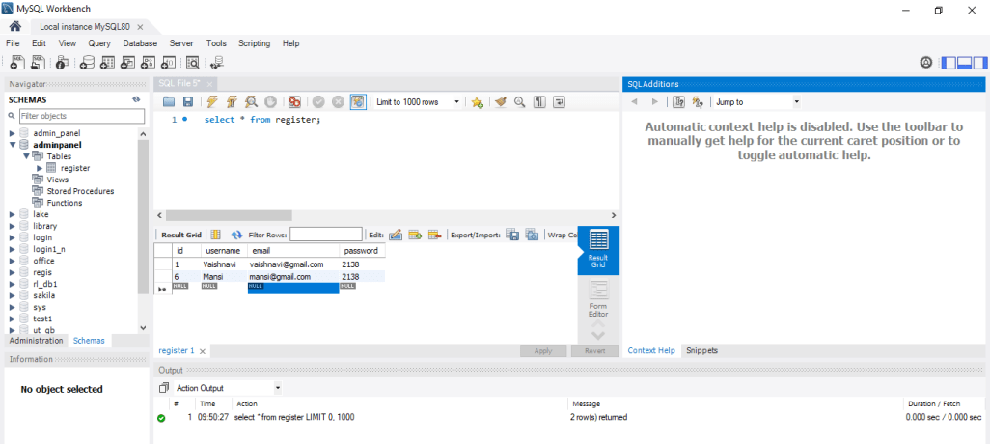
Backend:

Slide 25
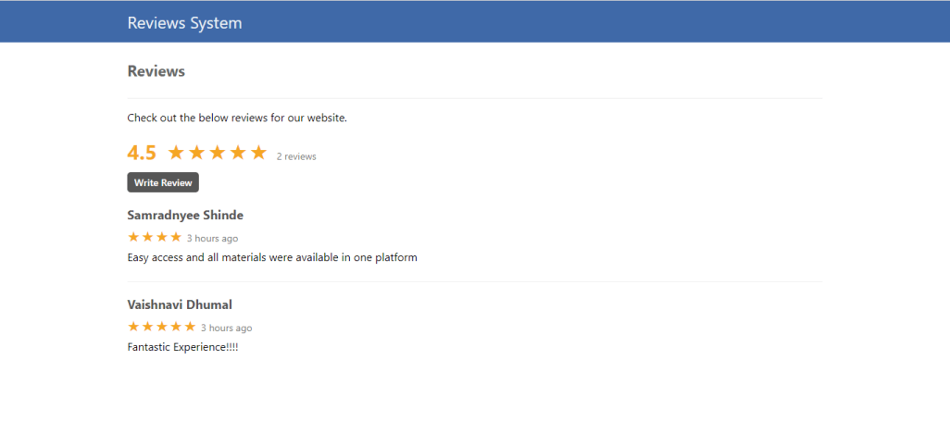
Reviews:
(Overall website)

Slide 26
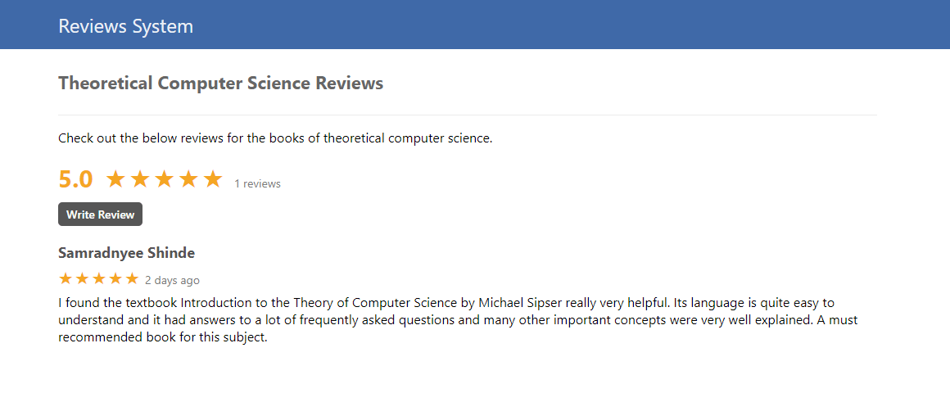
Reviews:
(Subject wise)

Slide 27
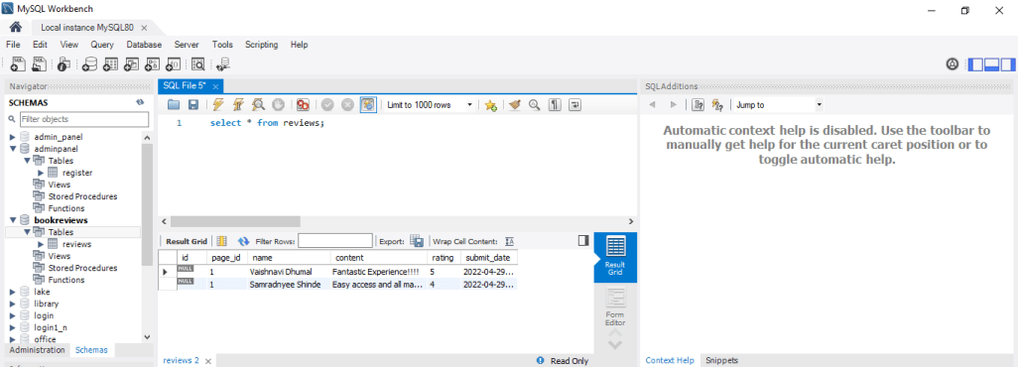
Backend:

Slide 28

Result
This Bookshop Automation System is an attempt to overcome the present inefficient and time
consuming process of locating, reserving and purchasing quality reading materials available in
the store. Currently, clients have to go through a time consuming process to perform
aforementioned tasks which cause waste of labor and firms resources. Through our automated
book store solution, we provide an easy way of referring books.
User data are validated and checked for authenticity with the data stored in the system database. All
the newly coined processes will address time consuming, ineffective and inefficient areas of
the existing system which has being wasting a lot of firms resources such as, labor, electricity,
equipment, products and services, while discouraging customers to make purchases and repelling
clients from the book store.

Slide 29
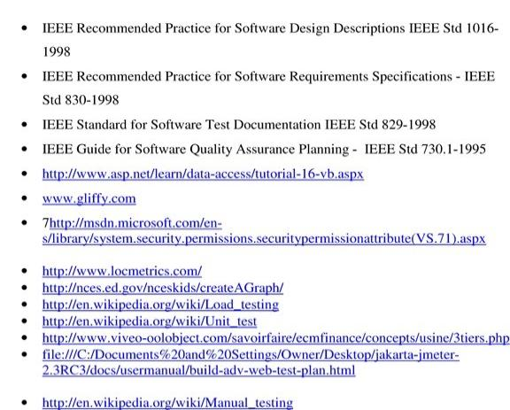
Bibliography

Slide 30

THANK YOU!

